Slide 1
NEXTHIKES IT SOLUTIONS
PROJECT NAME : BUILDING BASIC CALCULATOR
SUBMITTED BY : AVIRAL SINGH

Slide 2
Additional functionalities
Power Function (xʸ) : Calculates any number raised to another number. Example: Enter 2, then ^, then 3, and press = → Output: 8 (2³).
Square Root Function (√): Instantly computes the square root of the entered number. Example: Enter 16, then √ → Output: 4.0.
Error Handling: If you try to divide by zero or take the square root of a negative number, the calculator will show Error instead of crashing.
Clear Function (C) :Instantly resets both the current and total expressions so you can start a new calculation.
Decimal Support: Supports operations with decimal numbers (e.g., 3.14 + 2.71).
Formatted Output: All floating-point results are rounded nicely to 4 decimal places for cleaner display.
Operator Correction: If you accidentally input two operators in a row (e.g., 5++), it automatically replaces the previous operator with the new one,
avoiding invalid expressions.
Improved Layout & Visuals: Responsive grid layout for all buttons. Visually clear font hierarchy between the total expression and current input.
Slight padding for a cleaner, professional look.

Slide 3
Why I Used the Tkinter Library
Unaware of alternatives: initially didn’t know I could use PYQT, kivy, or web frameworks, so I chose Tkinter.
No extra installation: comes built-in with python, quick to start.
Beginner-friendly: simple and ideal for small-scale GUI projects.
Perfect for desktop apps: great fit for tools like calculators.
Easy layout design: grid system made UI structuring intuitive.
Customizable UI: adjusting fonts, colors, and button behavior was simple

Slide 4
Challenges faced & how did I overcame them
Being from the Non-technical background and doing any Programming project after more than 10 years, it really took some time to do coding and run my program.
While Python supports classes and objects , the implementation of classes , constructors and keywords is confusing.
Learning python is already an task for me but learning the Tkinter library by myself was really difficult.
Overcame all of these challenges by reading more about the Tkinter library and watching different tutorials.

Slide 5
References
Python Tkinter Documentation (Official) : 📌 URL: https://docs.python.org/3/library/tkinter.html
GeeksforGeeks:
📌 URL: https://www.geeksforgeeks.org/python-gui-tkinter/
Tkinter Course – FreeCodeCamp (Full 5-Hour Video)
📌 URL: https://www.youtube.com/watch?v=YXPyB4XeYLA

Slide 6
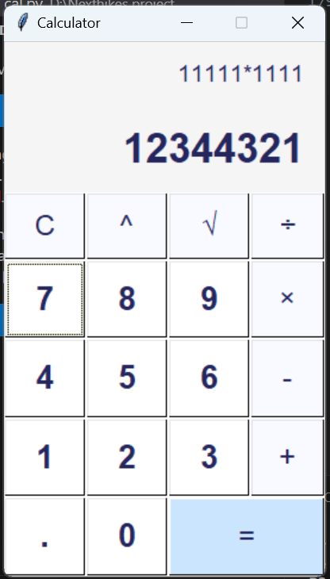
Screenshot of my Calculator

Slide 7
THANK YOU
Thankyou Nexthikes and Twinkle ma’am for giving us this Internship and helping us understand a littlebit about GUI development in Python through this Project.
I would again want to thanks Twinkle ma’am for guiding us step by step in this Internship.

